Slide 1
Strategic Leadership
607 MAN 303MAN
Analysing the strategic environment in a global context
Week 1 – Session 4

Slide 2



What we’re going to cover today…
(1)
Analysing the
environment
(3)
Segmentation and targeting
(3)
Government and
Industry issues

Slide 3
Session Outcomes
Evaluate and apply conceptual and practical approaches to strategic leadership in a range of different organisational settings.
Analyse contemporary research on the role of leadership in managing change.
Critically assess the relevance of leadership styles to key sector changes including globalisation, internationalisation, strategy, technological innovation and organisation development.
Identify and critically reflect on leadership capabilities and strategies of key Business leaders across a range of sectors.
Evaluate an incident of strategic organisational change by exploring the role of leadership and the measurement and management of Key Performance Indicators (KPI’s).
Critically explore the ethical relationships between leaders and followers in relation to decision making, corporate governance and policy practices in organisations.

Slide 4
Analysing the environment

Slide 5
Analysing the Main Elements of the Environment
Options
Environment
This session
Purpose
Options
Choice
Implement
Resources
Options
see Lynch (2018: 65)

Slide 6
Analysing the Strategic Environment
Strategically the environment means everything and everyone outside the organisation: competitors, customers, suppliers plus other influential institutions such as local and national governments” (Lynch 2018: 70)
Useful to take the tools in the following sequence:
General evaluation: market size, growth and share
Degree of turbulence
Green strategy
Factors affecting many industries: PESTEL analysis
Growth: Life-cycle analysis
Factors specific to the industry: Key factors for success
Factors specific to competition: Five Forces analysis
Factors specific to co-operation: Four Links analysis
Factors specific to immediate competitors
Customer analysis: demand, segmentation and positioning (Lynch 2018: 71)
Notes:
See: Lynch, Chapter 3

Slide 7
Step 1: General evaluation
Market definition and size
Market definition – what products/services do we include?
Is the market big or small?
Implications for business opportunity?
Market growth
Growing fast or slow?
Attractive opportunity or really mature?
Market share
Dominant company? Or fragmented market?
Notes:
Lynch, 2012 Ch 3, Section 3.2

Slide 8
Step 2: Measure the degree of turbulence
Low
High
Turbulence level
Changeability: the degree to which the environment is likely to change
Predictability: the degree to which such changes can be predicted
When both factors are high, essential to use emergent processes
Notes:
See: Lynch, Ch 3, Section 3.3

Slide 9
Definition and strategy implications What is green strategy?
“Green strategy concerns those activities of the organisation that are focused on both sustaining the earth’s environment and developing the business opportunities that will arise from such additional activities” (Lynch 2018: 471)
Sustainability is the underpinning principle: not necessarily profit maximisation
Strategy implications? Challenge to the economic foundations of strategic management.

Slide 10
Environmental analysis What is green strategy?
Three main areas:
Government legislation and directives
Business opportunities
Customer and consumer perceptions and pressures for change (see Elkington 1994; Hart 1997; Unruh and Ettenson 2010).

Slide 11
Step 4: Factors influencing many industries PESTEL Analysis
Consider the general environment surrounding many businesses under six main headings:
Political
Economic
Sociological
Technological
Environmental
Legal
Key point: PESTEL is not a ‘formula’, just a useful checklist – it is wise to be selective
Notes:
See: Lynch Ch 3, Section 3.5

Slide 12
Step 5: Growth and Life-Cycle Analysis
Theory suggests that businesses go through various phases of development
Strategies will change with each phase
Maturity
Growth
Decline
Sales
Introduction
Cash user phases
Cash generator phases
Time
(Lynch, 2018)
Notes:
See: Lynch Ch 3 Section 3.6

Slide 13
Step 6: Factors specific to the industry Key Factors for Success
Many industries or markets have factors that are essential to deliver profits in that market: the key factors for success (KFS) (see Ohmae 1983)
Useful to identify KFS because they will help set the agenda for strategy: if strategy fails to address these issues, it may fail completely
Useful also because there are many possible issues that might be considered by strategic management: KFS helps to select the key issues
Notes:
Lynch checklist of KFS areas: Section 3.7

Slide 14
Step 7: Factors specific to competition Five Forces Analysis
Underpinning logic: economic power in the market place
Key question: how much bargaining power does a company have against the five forces acting against it?
The Five Forces: each with an example of their power
Industry competitors – e.g. some may have stronger brands
Customers – e.g. may be large enough to dictate buying terms
Suppliers – e.g. perhaps supplying a unique ingredient
Substitutes for the company’s products – e.g. may be cheaper
Potential new entrants – e.g. could enter the market with new technology and threaten the company’s existence

Slide 15
Step 7: Factors specific to competition Five Forces Analysis
How to analyse the Five Forces:
Customers: have high, medium or low bargaining power based on size of order, etc
Potential entrants: high, medium or low threat of new entrants based on barriers to entry
Industry competitors: high, medium or low threat based on competitors’ resources, plans, etc.
Suppliers: have high, medium or low bargaining power depending on what they supply – patented, quality, etc
Substitutes: high, medium or low threat based on ease and cost of alternative, etc.
(Porter 1980)
Notes:
See: Lynch, Ch 3, section 3.8

Slide 16
Step 8: Factors specific to co-operation Four Links Analysis
Government links and networks
Informal co-operative links and networks
The organisation
Complementors
Formal co-operative links
(Lynch, 2018: 97)
Notes:
Underpinning logic: economic benefits derived from working together
See: Lynch Section 3.9

Slide 17
Step 8: Factors specific to co-operation Four Links Analysis
Government links and networks: Government contracts are crucial to some companies and informal networks are important to influence government tax legislation, R&D support, gain government support grants, etc.
For example, Sony has had strong support from the Japanese government over investment in electronics
Informal co-operative links and networks: alliances, mutual industry support, informal talks – but price agreements illegal!
Formal co-operative links: joint ventures and other forms of contractual co-operation
Economic benefits from all the above areas

Slide 18
Step 8: Factors specific to co-operation Four Links Analysis
Complementors: companies whose products add more to the products of the base company than they would possess by themselves
For example, Sony Vaio computers – the base company - benefit from having the widely accepted Microsoft Windows software as the complementor
Microsoft complements Sony
Coca Cola complements McDonalds Restaurants, etc.
Economic benefits from powerful complementary links between well-respected products and brands

Slide 19
Four Links Analysis: how to assess the links
Explore via strong, medium or weak links between the organisation and the four link areas
Government links and networks
Informal co-operative links and networks
The organisation
Formal co-operative links
Complementors
(Lynch, 2018)

Slide 20
Step 9: Factors specific to immediate competitors
The following aspects of the competitor’s organisation need to be explored:
Objectives
Resources
Past record of performance
Current products and services
Present strategies
Examine in depth for a few rivals only
Notes:
See: Lynch Section 3.10

Slide 21
Step 10: Customer analysis Demand, Segmentation and Positioning
The following aspects need to be explored:
Customer profiling
Market segmentation
Market positioning
Present customer strategies
Examine in depth for company’s products
Keypoint: Competitive analysis is important in strategy, but ultimately it is the Customers who make the buying decision
Notes:
See: Lynch, Section 3.11

Slide 22
Segmentation and Positioning

Slide 23
Customer profiling - 1
Customer profiling describes the main characteristics of the customer and how customers make their purchasing decisions
Important because an understanding of why customers buy will indicate to an organisation where they need to develop and sustain their competitive advantages
Competitive advantage in strategy is only meaningful if it attracts customers, e.g.
Gucci may or may not be a low-cost producer of its high quality fashion items but this is largely irrelevant to that company’s customers
Mars’ Snickers has good quality ingredients, but retail price/value versus competing products is equally important

Slide 24
Customer profiling - 2
Some examples:
Domestic customers, e.g. people buying confectionery
Buy products for themselves and their families
Individual bargaining power usually low
Often grouped together into segments
Large industrial customers, e.g. airlines buying passenger jets
Each customer has different needs
Tend to buy for more rational and economic reasons
Buying power if individual customers sufficient to justify special attention
Public service customers, e.g. local library or housing service
Customers may be grouped into segments
Service important: people providing service are part of ‘product’
But profit may not be prime motive

Slide 25
Segmentation and positioning - 1
Market segmentation is the identification of specific groups (or segments) of customers who respond to competitive strategies differently form other groups
Positioning is the choice of a differential advantage possessed by an organisation that allows it to compete and survive in a market place in a segment of a market
In theory, it is possible to position a product without considering segmentation – perhaps for a unique new product or service
In practice, segmentation usually comes first, especially in consumer markets
Typical sequence: identify segments and then position product or service within segment
Notes:
In developing product marketing, basic considerations will include an examination of customers and consideration of the product lifecycle. However, it rapidly becomes clear that product issues will benefit from careful consideration of the areas above. (Doyle, Chapter 3)
Identify market segment(s): studying the needs of particular parts of the market will allow marketing to be more directed and persuasive.
1. Identify customer needs and segment the market
2. Develop profiles of resulting segments
Evaluate market segments: some segments will be more attractive than others. These need to be identified and targetted for the highest potential.
1. Evaluate attractiveness of each segment
2. Select target segments
Position within market segment: within the chosen segment, companies then need to build a differential advantage over competitors. A marketing mix is then needed to implement this position.
1. Identify differential advantage for chosen segment (s).
2. Develop marketing mix to implement
Marketing planning: within each segment, a plan is then required to implement the positioning strategy from a prescriptive perspective.

Slide 26
Segmentation and positioning - 2
Identification of specific groups (or segments) of customers who respond differently from other groups to competitive strategies
Criteria for selecting useful market segments:
Distinguishable: customers must be sufficiently distinctive so that they can be isolated in some way
Relevant to purchasing needs of customer
Sufficient size to justify special strategies and their associated costs
Reachable so that it is possible to direct the strategy to the segment (see Aaker 1992).

Slide 27
Segmentation and positioning - 3
Emergent sequence of development shown below
Prescriptive process similar but has no feedback mechanism
Relatively easy to identify market segments using marketing research
Positioning within segment not so simple – requires experimentation with actual or potential customers and judgement on the most attractive gaps
Identify market segment(s)
Evaluate market
segments
Position
within
market
segment
Customer-driven strategy
Feedback
yle,2006, in Lynch, 2012)
Notes:
In developing product marketing, basic considerations will include an examination of customers and consideration of the product lifecycle. However, it rapidly becomes clear that product issues will benefit from careful consideration of the areas above. (Doyle, Chapter 3)
Identify market segment(s): studying the needs of particular parts of the market will allow marketing to be more directed and persuasive.
1. Identify customer needs and segment the market
2. Develop profiles of resulting segments
Evaluate market segments: some segments will be more attractive than others. These need to be identified and targetted for the highest potential.
1. Evaluate attractiveness of each segment
2. Select target segments
Position within market segment: within the chosen segment, companies then need to build a differential advantage over competitors. A marketing mix is then needed to implement this position.
1. Identify differential advantage for chosen segment (s).
2. Develop marketing mix to implement
Marketing planning: within each segment, a plan is then required to implement the positioning strategy from a prescriptive perspective.

Slide 28
Segmentation and positioning - 4
Process of developing market positioning:
Perceptual mapping: in-depth qualitative research on actual and prospective customers to see how they make decisions in the market place
Positioning: existing brands are then placed on the map using the above research
Options development: existing and new products are analysed for their strengths and weaknesses to fill new positions on the map
Testing: simple experiment with a few customers and then in the market place

Slide 29
Tata Motors Video
https://www.youtube.com/watch?v=jP8q936Ex2c#action=share

Slide 30
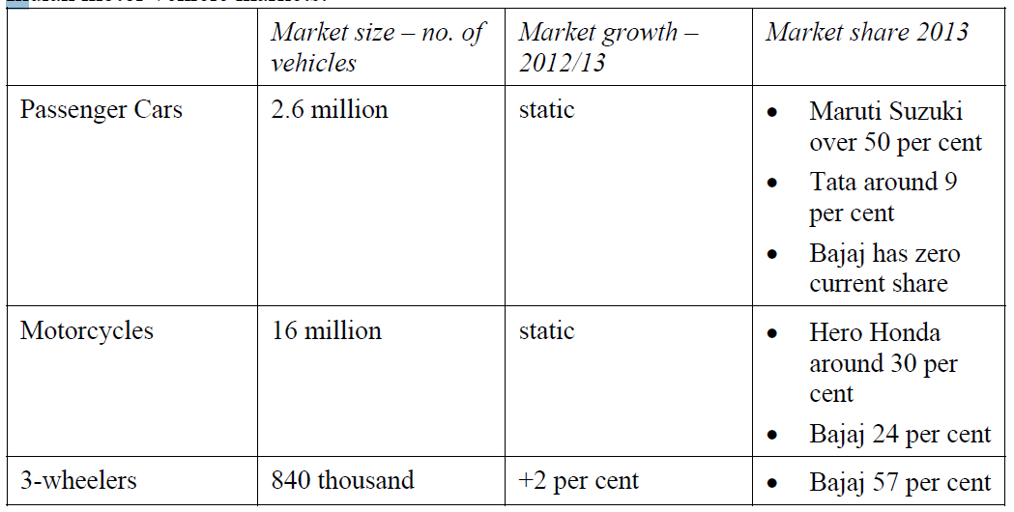
Three main Indian motor vehicle markets

Slide 31


Report
Class discussion
60 minutes
Working in pairs you have 60 minutes to research Tata Motors and apply the ten basic analytical tools.
Environmental analysis, the ten basic stages include:
degree of turbulence, green strategy, PESTEL, industry life cycle, key factors for success, five forces, four links, competitor analysis, customer analysis.
• Resources and capabilities analysis, e.g. the two main value added areas of value chain and value system coupled with the three main areas of competitive advantage based on tangible and intangible resources and organisational capabilities

Slide 32
Some strategy options for Tata
Passenger cars in India: new joint ventures?
Passenger cars in India: what to do about the Nano?
Passenger cars outside India: how to develop the success of JLR?
Passenger cars outside India: does the Nano have any potential?
Commercial vehicles in India: how to exploit Tata’s dominance
Commercial vehicles outside India: whether to exploit and, if so, how to exploit Tata’s knowledge and expertise?

Slide 33
Government and Industry issues

Slide 34
Five political trends that have impacted Strategic Management
Decline of the centrally directed command economies of Eastern Europe coupled with the move towards democracy and freer markets
The absence of world wars and the more recent end of the Cold War
The relative weakness of African and South/Central American economies
The rise of international trade, global companies and new trading nations
Emergence of supportive international finance and economic institutions such as the World Bank and International Monetary Fund.

Slide 35
Government and industrial policy - 1
Basic policy:
Laisser faire: free market approach
Dirigiste: centrally directed approach
Broader analysis of government policy and state institutions:
Public expenditure
Competition policy
Taxation policy
Regional policy

Slide 36
Government and industrial policy - 2
Analysis needed at two levels:
National economy: macroeconomic level to determine growth, inflation and policies for many organisations
Industry-level studies: to establish government attitudes to specific industries in areas such as competition policy, support, employment

Slide 37
Report
Group work
30 minutes
You have 30 minutes to critically discuss in groups of 3 or 4 what the role of government is in business.
Your tutor will choose who needs to address the whole class...

Slide 38
What we’ve to covered today…
(1)
Analysing the
environment
(3)
Segmentation and targeting
(3)
Government and
Industry issues

Slide 39

Traffic Light it
Where is your learning at?
Red = I have misunderstood some of the topics. (write down 2 questions that you need help with)
Amber = I have understood most of the topics so far (write down 1 question and 1 key theme you have understood)
Green = I have understood the topics so far (write down 2 key themes from the lesson to show your understanding)

Slide 40

Reading list
Essential Reading
Lynch, R., (2021) Strategic Management. 9th edn. London: Pearson Education
Yukl, G. (2020), Leadership in Organizations: Global Edition. 9th edn. Los Angeles: SAGE
Recommended Reading
Robbins, S.P., De Cenzo, D.A., Coulter, M. (2020) Fundamentals of Management: Management Myths Debunked! Global Edition. 11th edn. Harlow: Pearson
Johnson, G., Whittington R., Scholes K. (2020) Exploring Strategy: Texts and Cases. 12th edn. Harlow: Pearson.

